Slide 1
Time | Title
9:00 AM - 9:15 AM | Introduction & Day Overview | Damian
9:15 AM - 10:00 AM | Session #1: Introduction to the .NET Core SDK | Damian
10:00 AM - 10:15 AM | Break
10:15 AM - 10:45 AM | Lab #1 | Get bits installed, create first app
10:45 AM - 11:30 AM | Session #2: Introduction to ASP.NET Core | Jon
11:30 AM - 12:00 PM | Lab #2 | WebHost, Startup, Configuration, Environments, Middleware, & IIS
12:00 PM - 1:00 PM | Lunch
1:00 PM - 1:45 PM | Session #3: Introduction to Routing & MVC | Jon
1:45 PM - 2:15 PM | Lab #3 | Routing patterns, MVC basics, etc.
2:15 PM - 3:00 PM | Session #4: Logging & Error handling | Damian
3:00 PM - 3:15 PM | Break
3:15 PM - 3:45 PM | Lab #4 | Using logging abstractions & providers, diagnostics pages/middleware
3:45 PM - 4:30 PM | Session #5: Dependency Injection & Testing | David
4:30 PM - 5:00 PM | Lab #5 | Use DI for application services, add a unit test project

Slide 2
Time | Title
9:00 AM - 9:15 AM | Introduction & Day Overview
9:15 AM - 10:00 AM | Session #6: Razor & Tag Helpers | Damian
10:00 AM - 10:15 AM | Break
10:15 AM - 10:45 AM | Lab #6 | Working with Tag Helpers
10:45 AM - 11:30 AM | Session #7: MVC Web API | David
11:30 AM - 12:00 PM | Lab #7
12:00 PM - 1:00 PM | Lunch
1:00 PM - 3:00 PM | App building: Attendee List
3:00 PM - 3:15 PM | Break
3:15 PM - 4:00 PM | Session #8: Single Page Applications | Jon
4:00 PM - 4:45 PM | Lab #8 | Single Page Applications or Deploy app to azure
4:45 PM - 5:00 PM | Summary & Conclusion

Slide 3
Intro to ASP.NET Core
Jon Galloway
Technical Evangelist
@jongalloway
jon.galloway@microsoft.com

Slide 4
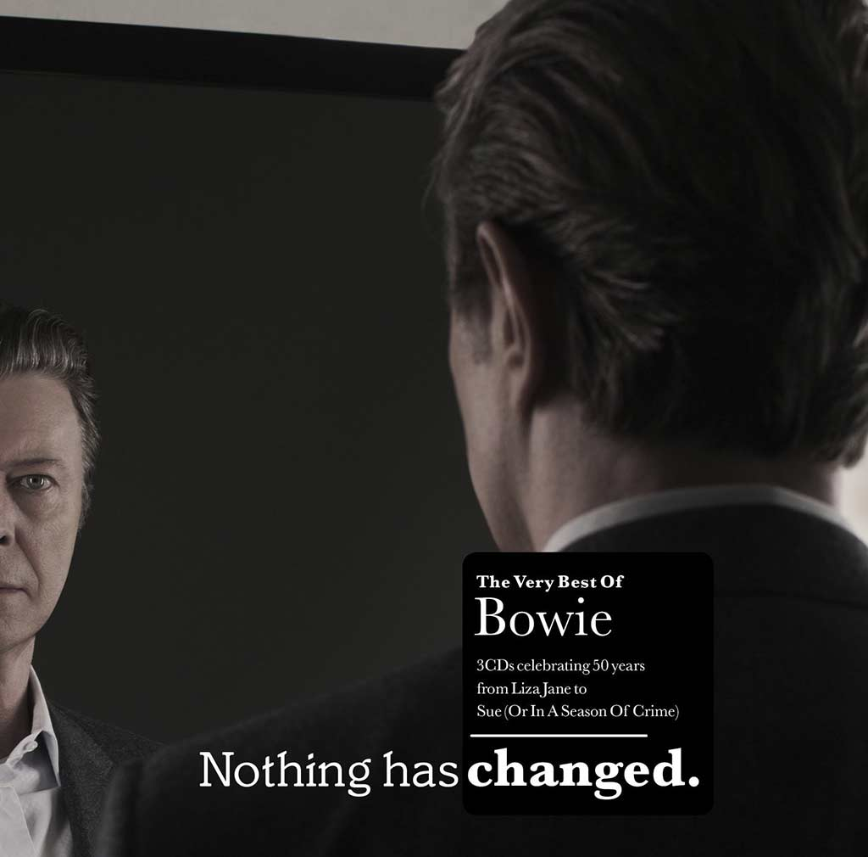
Demo: Nothing has changed!

Slide 5
MSBuild -> csc.exe
CodeDOM -> csc.exe
Application
dotnet (Roslyn)
Loose, GAC, NuGet
Libraries
NuGet
Open Source
FCL, GAC, NuGet
Application Frameworks
NuGet
IIS
Web Server
Kestrel
System.Web
Application Host
Application
.NET BCL & FCL
Platform Libraries
.NET BCL & FCL
.NET on NuGet
.NET CLR
Runtime
.NET CLR
.NET Core CLR
IIS: WebEngine4.dll
Exe: OS
Runtime Loader
dotnet
Windows
Operating System
Windows, OSX, Linux

Slide 6
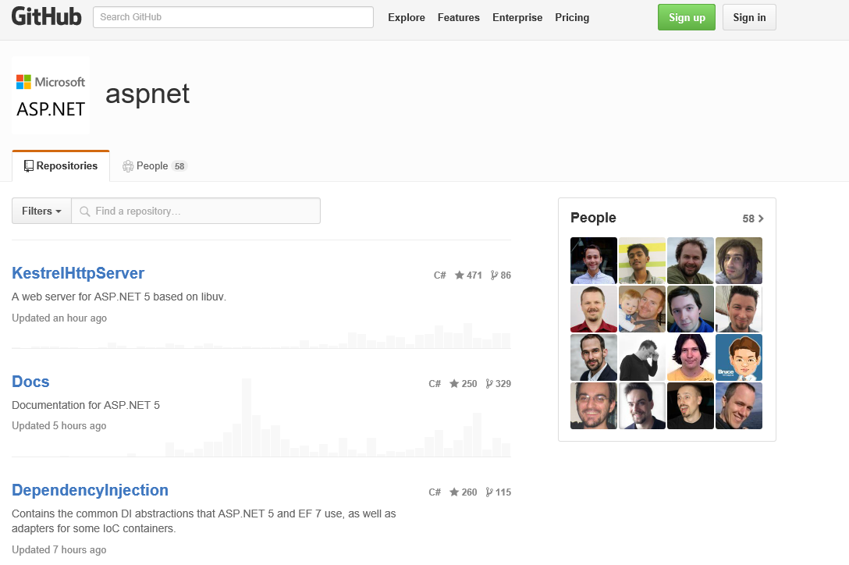
github.com/aspnet

Slide 7

Demo: Everything has changed!

Slide 8


ASP.NET Core and the Modern Web
Totally Modular
Faster Development Cycle
Seamless transition from on-premises to cloud
Choose your Editors
and Tools
Open Source with Contributions
OSS
Cross-Platform
Fast

Slide 9
Hosting

Slide 10
Middleware

Slide 11
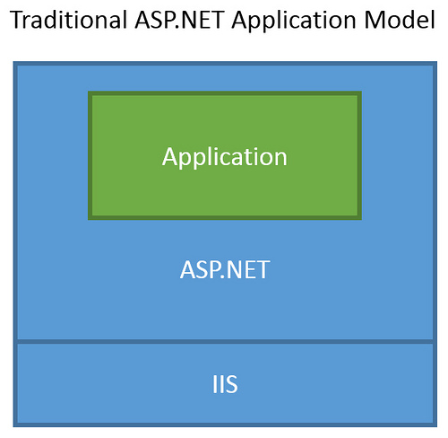
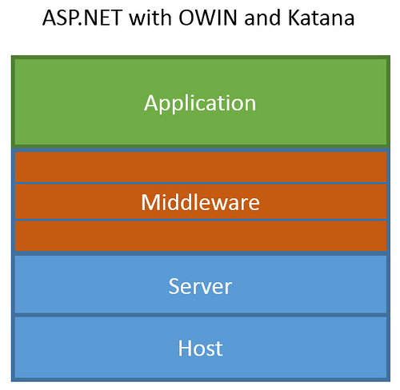
ASP.NET Core Middleware
Traditional ASP.NET Application Model
ASP.NET Core Middleware

Slide 12
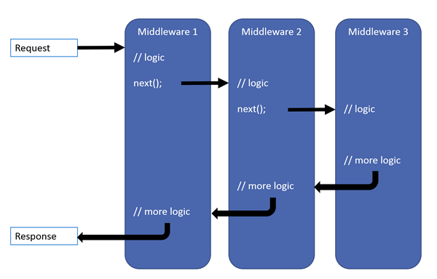
ASP.NET Core Middleware

Slide 13
Configuration

